Slide 1


OpenSim – Python
Hernandez Vincent

Slide 2

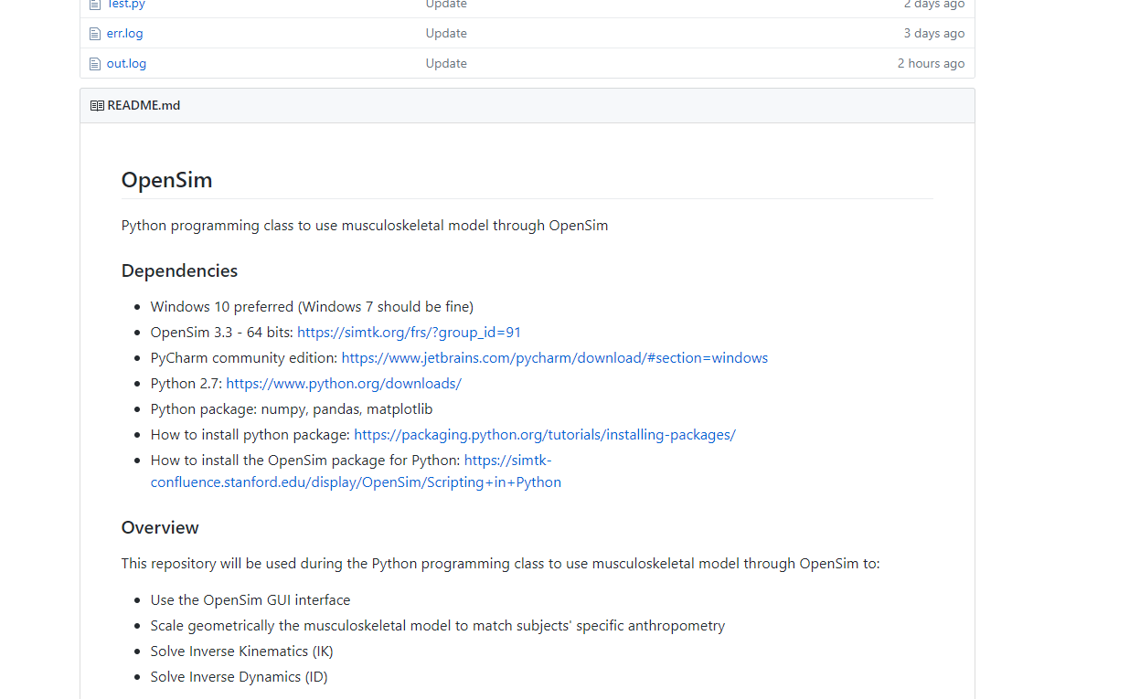
2
GitHub repository
GitHub repository:
https://github.com/GVLABHernandez/OpenSim

Slide 3

3
Install OpenSim 3.3
OpenSim:
https://simtk.org/frs/?group_id=91
Create your login and password to download it
OpenSim will be install at the root of your hard drive (C:\OpenSim 3.3)

Slide 4
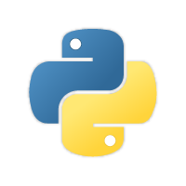

4
Install Python 2.7 and PyCharm
Python 2.7.14:
https://www.python.org/downloads/release/python-2714/
Download this file: Windows x86-64 MSI installer
PyCharm community edition:
https://www.jetbrains.com/pycharm/download/#section=windows

Slide 5
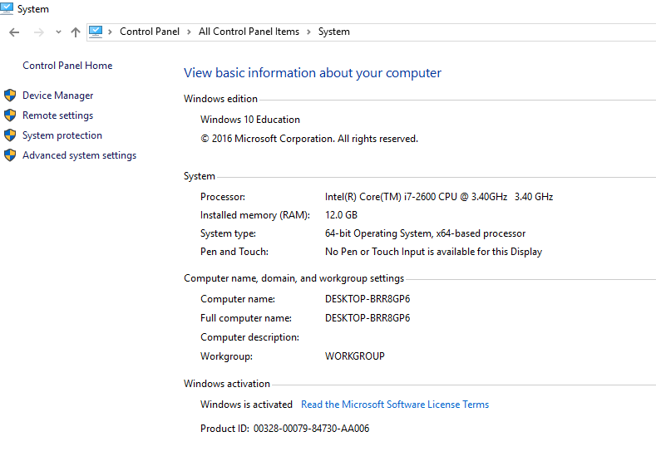
5
Insert Python 2.7 scripts into the System Path
Control Panel -> System -> Advanced system settings -> Environment variables

Slide 6
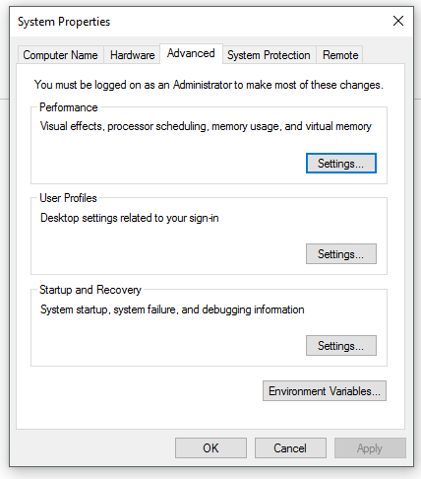
6
Insert Python 2.7 scripts into the System Path
Control Panel -> System -> Advanced system settings -> Environment variables

Slide 7
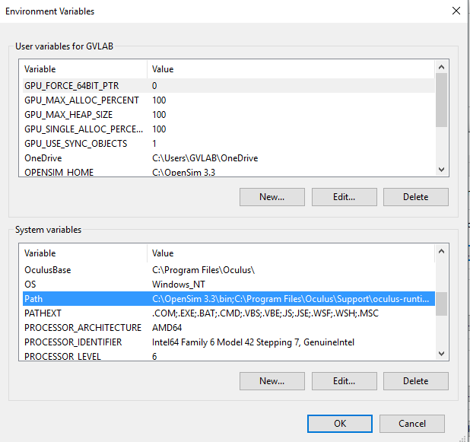
7
Insert Python 2.7 scripts into the System Path
Control Panel -> System -> Advanced system settings -> Environment variables

Slide 8
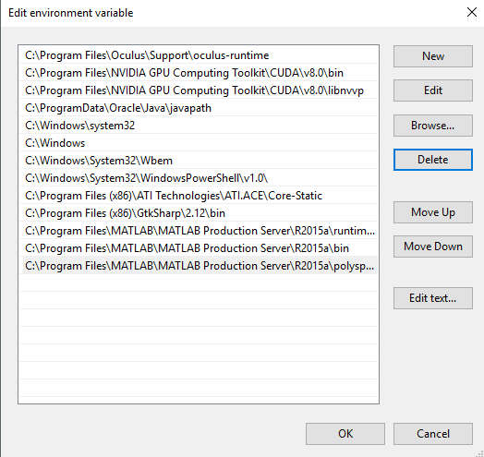
8
Insert Python 2.7 scripts into the System Path
Control Panel -> System -> Advanced system settings -> Environment variables
C:\Python27\Scripts

Slide 9
9
Insert OpenSim into the System Path
Control Panel -> System -> Advanced system settings -> Environment variables

Slide 10
10
Insert OpenSim into the System Path
Control Panel -> System -> Advanced system settings -> Environment variables

Slide 11
11
Insert OpenSim into the System Path
Control Panel -> System -> Advanced system settings -> Environment variables

Slide 12
12
Insert OpenSim into the System Path
Control Panel -> System -> Advanced system settings -> Environment variables
C:\OpenSim 3.3\bin

Slide 13
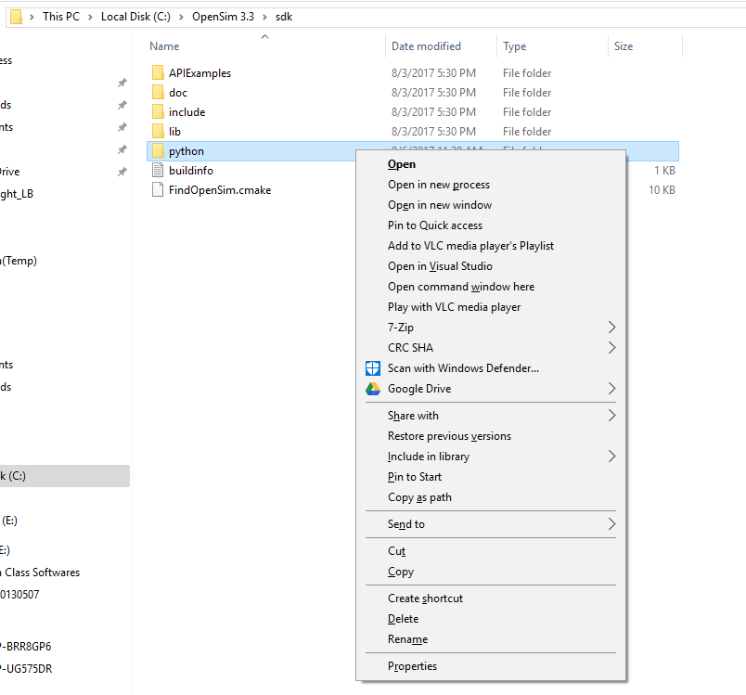

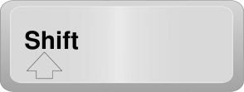
13
Run the OpenSim Setup File from Command Line
C:\OpenSim 3.3\sdk
+
Shift + Right-Click on the python folder

Slide 14
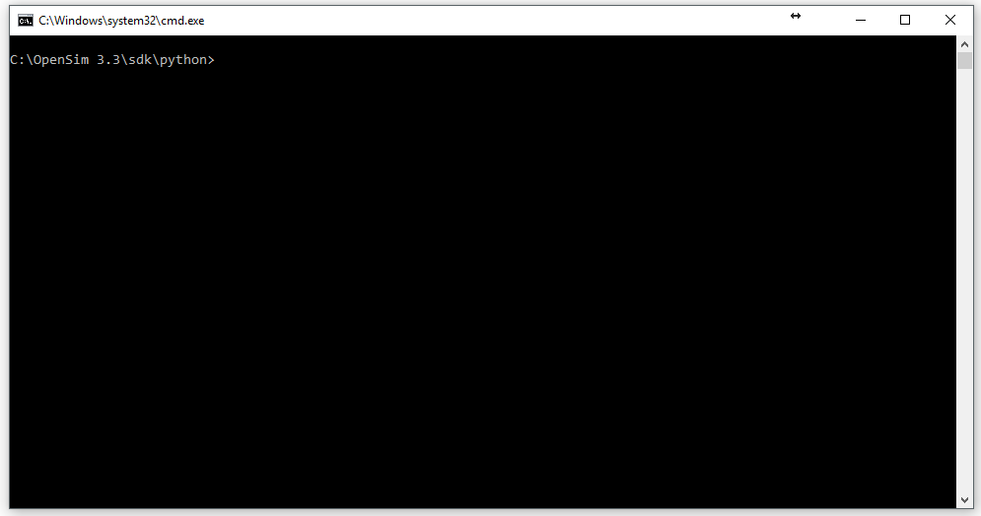
14
Run the OpenSim Setup File from Command Line
python setup.py install or py -2.7 setup.py install

Slide 15
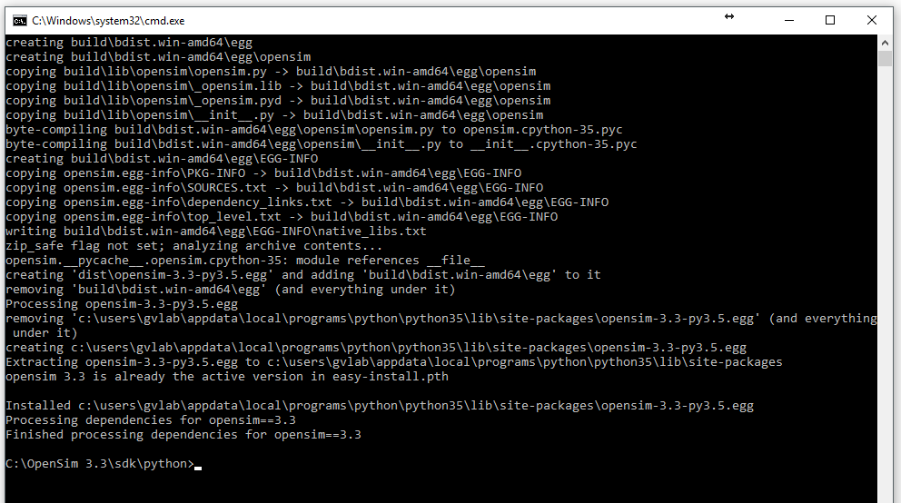
15
Run the OpenSim Setup File from Command Line
You should have something like that

Slide 16
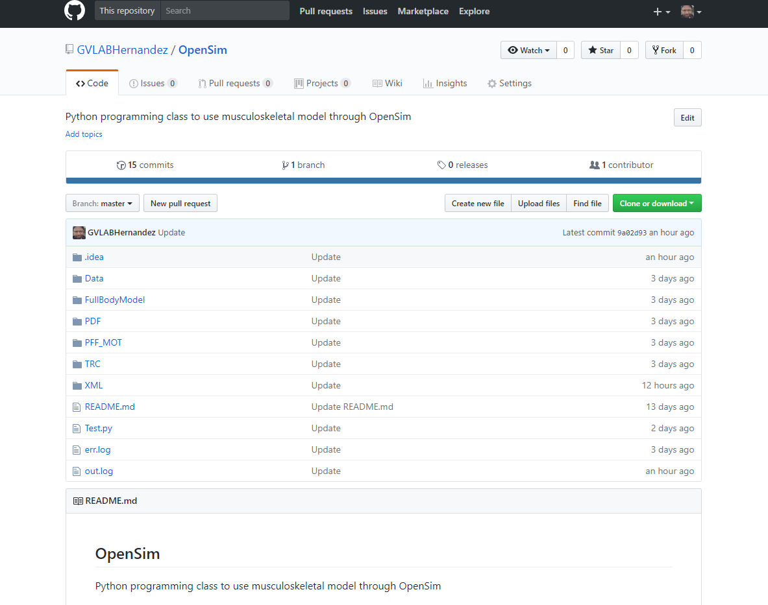
16
Download the GitHub repository
GitHub repository:
https://github.com/GVLABHernandez/OpenSim
Decompress the .zip file on your desktop

Slide 17
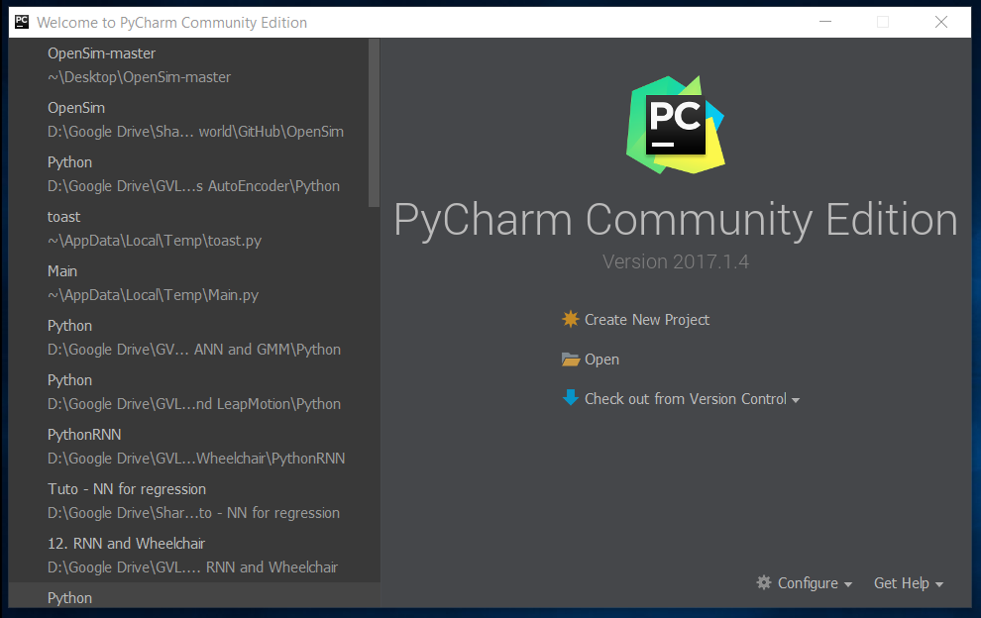
17
Test
Open PyCharm and click on Open

Slide 18
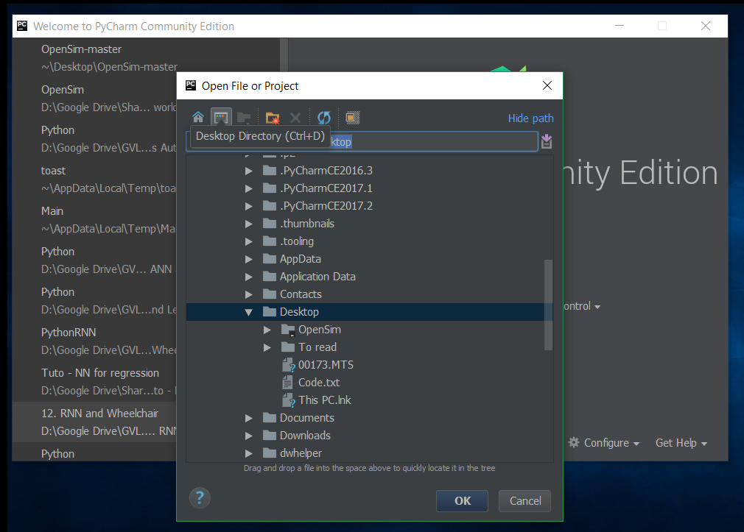
18
Test
Click on this icon to have access to your desktop

Slide 19
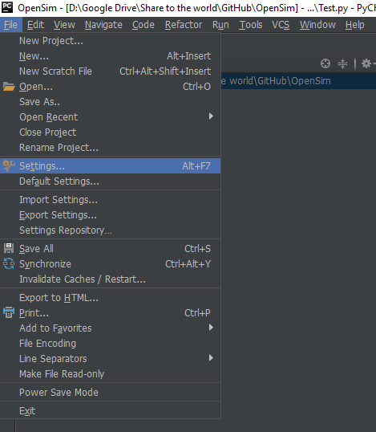
19
Test
Check the Python interpreter for this project

Slide 20
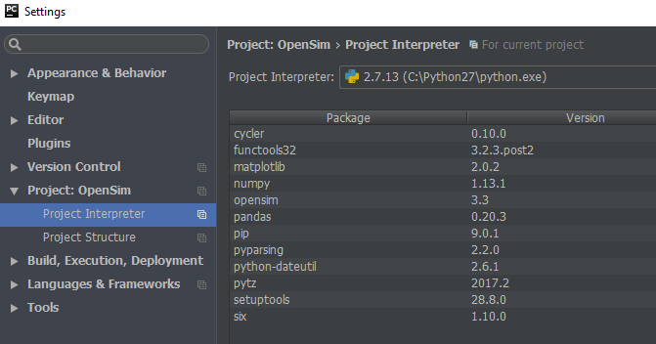
20
Test
Check the Python interpreter for this project

Slide 21
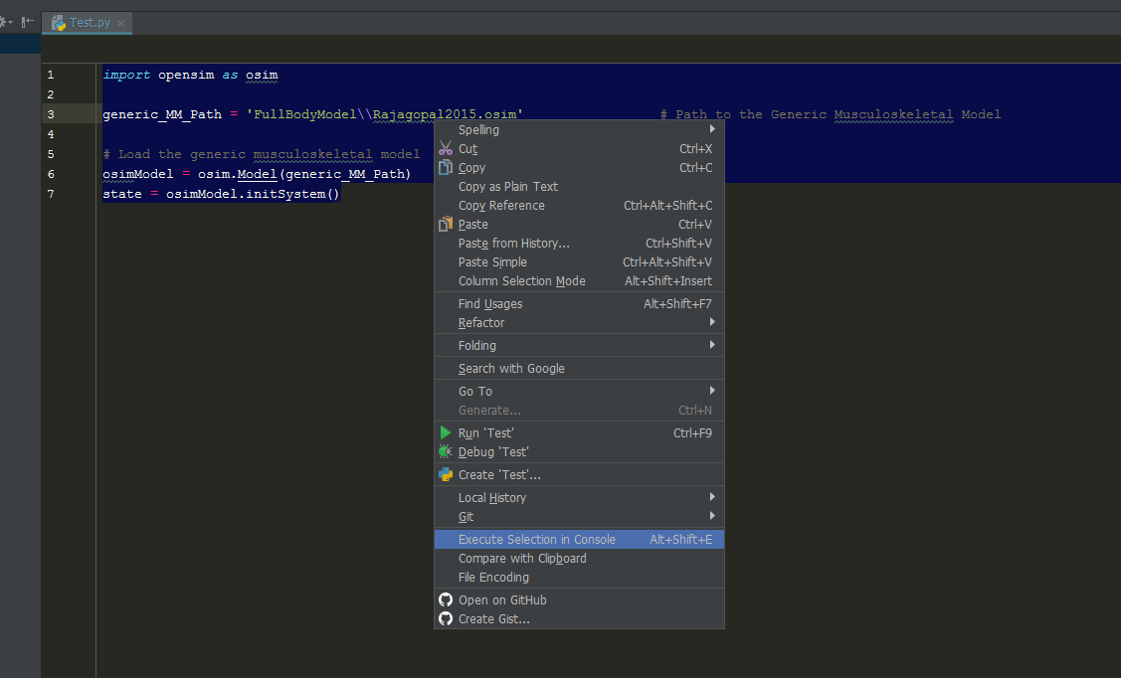
21
Test
Select all the code. Then, right-click on it and left click on Execute Selection in Console

Slide 22
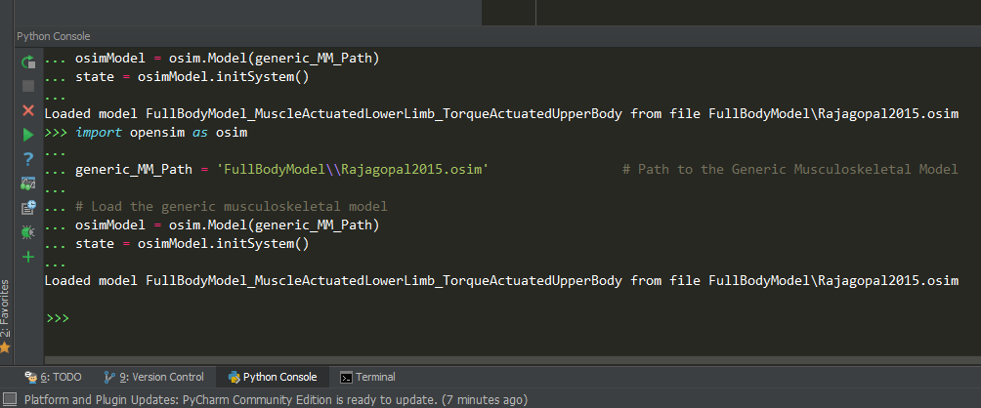
22
Test
Select all the code. Then, right-click on it and left click on Execute Selection in Console

Slide 23
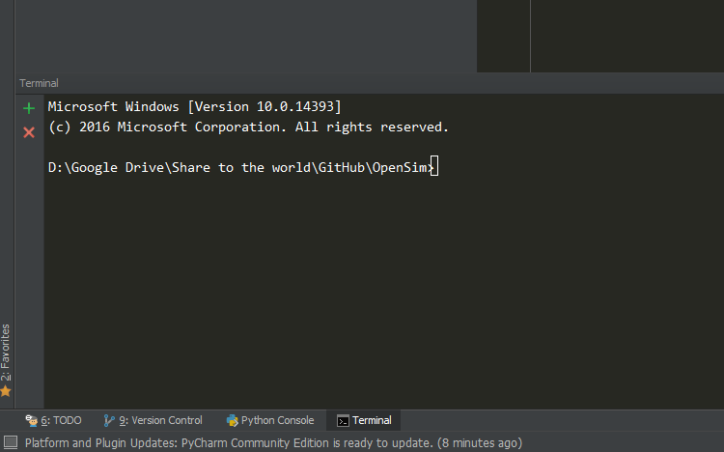
23
Install the python libraries
Python package:
Numpy, matpoltlib and pandas
pip install numpy
(py -2.7 –m pip install numpy)
pip install matplotlib
(py -2.7 –m pip install Matplotlib)
pip install pandas
(py -2.7 –m pip install pandas)

